Slide 1
ASE Project Fettle Up
Saketh Garuda (Class id:25)
Sarat Mudunuri (Class id:52)
Sreelakshmi Nandanamudi (Class id:60)
Sowmya Yalamanchili (Class id:91)

Slide 2
Significance
Application allows users to
Communicate with doctor using chat service.
Book an appointment with the respective doctor.
Search for nearby emergency with ease.

Slide 3
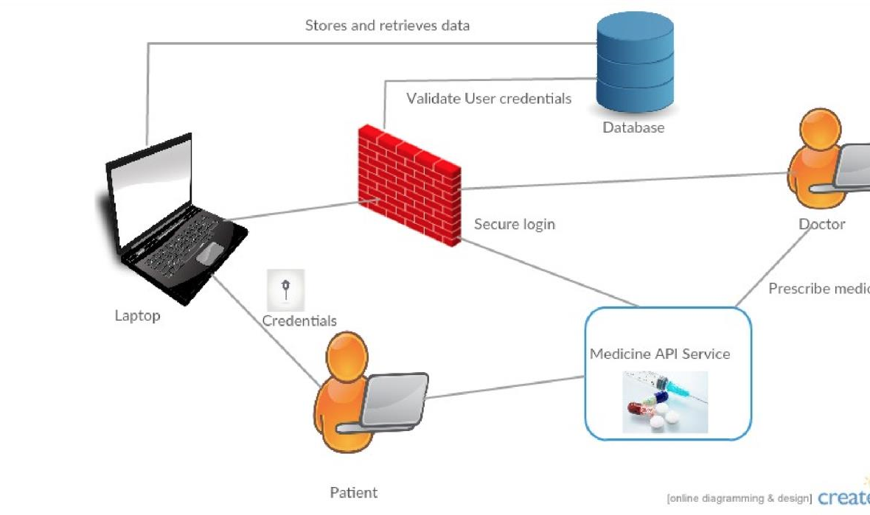
Architecture Diagram

Slide 4


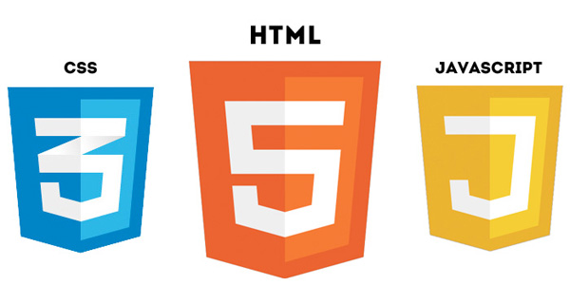

Technologies Used

Slide 5
Application Features
User can create account and login.
Google login using oAuth.
Chat with doctor using Speech to text API.
A confirmation mail is sent to the doctor about the appointment.
Check for nearby emergency stores.
Patient Health details can be viewed by doctor.
Video Link: https://youtu.be/q6T6_80xi3U

